Slide 1
Sports Prediction: AI&ML
Lightning Talks
Erico Fernandes

Slide 2


Sports Prediction: AI&ML
When speaking about sports predictions it’s inevitable for some of us, not to think about predicting scores, results , games features and other outcomes... Even getting some easy revenue out of it...
But with AI & ML there is more to explore in sports modern thinking

Slide 3
Using AI and Machine Learning to gain other insights... Some examples:
Make informative decisions about marketing strategies to atract,engage with fans and for therefore retain revenue
Leverage team and player’s overall performance
Real-time decision-making by coaches on Game Analysis and Strategy
Real-time decision-making by Referees
Anticipate risk of injuries and provide solutions in Injury prevention and Rehabilitation
Development of personalized Training Programs to support the above
Supporting and Improving Recruiting and Scouting activities

Slide 4
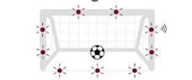
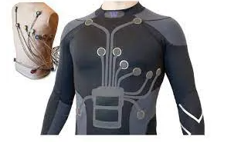
Examples of AI supporting Tools in Sports:
Goal-Line Technology (GLT)
What is the goal-line technology magnetic field?
The Tech Behind Goal Line Technology At the point when the ball crosses the goal-line, the goal mouth magnetic field is disturbed. A signal is generated and transmitted to the system computer, which in turn transmits a signal to the referee's watch enabling the 'goal' allowed or disallowed
NBA chatbot : Increased Fan Engagement and Revenue
NBA partners team up with AI chatbot company GameOn Technology to engage with the fans. The chatbot delivers updates as games unfold as well as game previews
Through chatbot technology, fans can automatically and immediately obtain the answers they need to commonly asked questions, which enables teams to take advantage of a fan’s interest .(data retrieving for marketing analytics purposes).
Smart wearables allowing:
Biometric Monitoring and Analysis and real-time tracking of players’ health , fatigue, performance and injuries possibility.

Slide 5
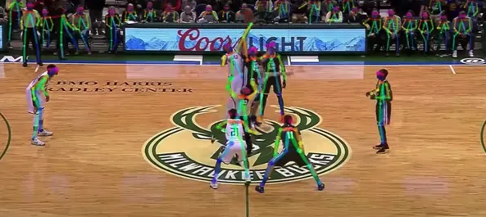
Examples of AI supporting Tools in Sports:
“Algorithms methods developed in Cornell's Laboratory for Intelligent Systems and Controls , team up with Computer Vision and Image Recognition tech tools to help predict the in-game actions of volleyball players with more than 80% accuracy”
The algorithms use their unique features to they take a holistic approach to action anticipation, combining also Player Tracking and Motion Capture Technology
The data retrieved from several game footages in soccer, basketball , hockey and other sports offered the Cornell’s data science team with algorithms that autonomously identify players, actions and game scenarios.
Other positive outcomes were immediately identified ,such as:
-Automation in game film annotations, that were being performed manually by team staff members.
- With existing game footages of an opponent, patterns were discovered, that helped anticipating players actions and therefore improved preparation and game strategies

Slide 6
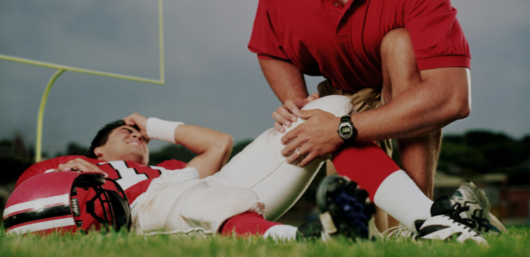
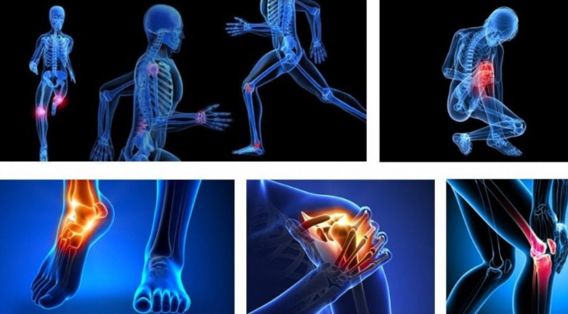
Sports prediction: The insights that really matter
We saw previously that sports predictions using data analytics don’t necessary need to be associated with guessing match results or outcomes.
Therefore the next slides are insights about the role of AI and ML in preserving physically the main protagonists of the sports we love the most.

Slide 7

AI & ML in sport injury prediction and prevention
Machine learning (ML) methods are being used to improve injury prediction and allow proper approaches to injury prevention.
What follows is a systematic approach to injury prediction and prevention based on a set of original studies published in :”Sports Medicine Open Center” investigating the role of ML for sport injury prediction and prevention.
58 studies included in the review 11 AI techniques or methods applied in 12 team sports.

Slide 8
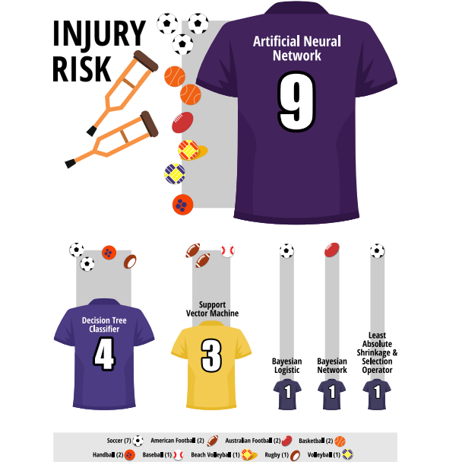
AI & ML in sport injury prediction and prevention
For injury risk possibility, the following techniques and methods were applied
Artificial neural network;
Decision tree classifier;
Support vector machine;
Bayesian logistic;
Absolute shrinkage and selection operator;
Fuzzy clustering;
K-means clustering;
K-nearest neighbor;
Markov process;
Artificial neural network, decision tree classifier and support
Vector machine were the techniques and methods most used for
injury prediction model

Slide 9
Artificial neural network briefly explained

Slide 10
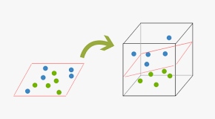
Support vector machine

Slide 11
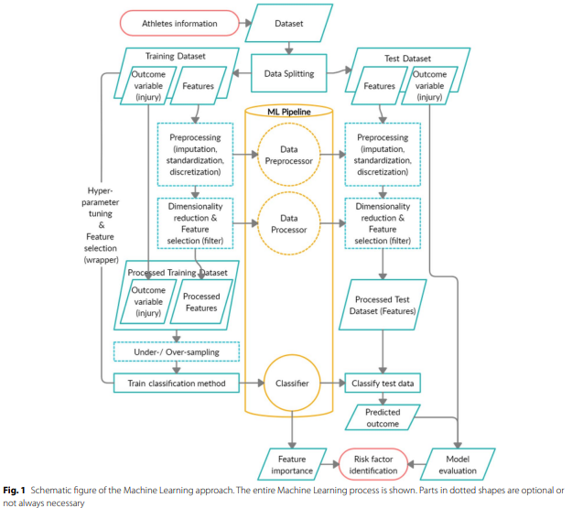
Systematic review of the 11 eleven studies:ML procedure in injury prediction

Slide 12
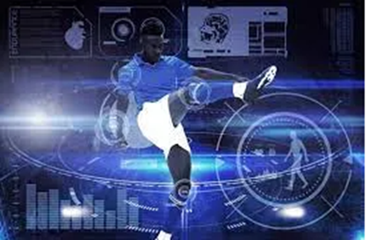
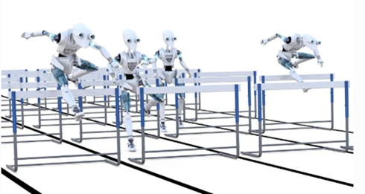
Injury Predictors(important features) of Yes Injury or No Injury
Sleep Quality
History of muscle
Injury in last season
Interactions of asymmetry, knee valgus angle and body size
Higher predicted age at PHV (peak height velocity)
lower body fat percentage.
Mean days between consecutive games,
Training load variable varied for each player
Soft tissue scores
Stress level
Ankle flexibility
Age
Body Mass/composition
Neuromuscular control
Genetic markers
Anthropometric measurements, motor coordination and physical fitness
Psychological and neuromuscular measurements
Player’s role/position

Slide 13
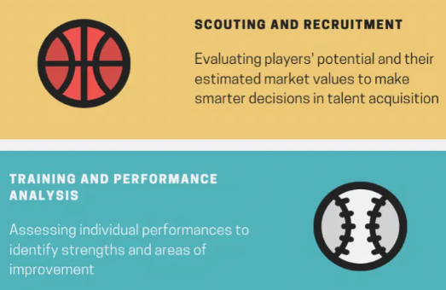
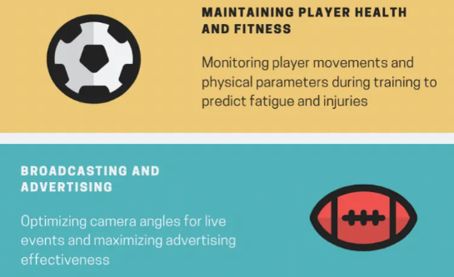
Conclusions
Not all aspects in the world of sports are quantifiable
The aspects that can be quantified, can be predicted with a certain level precision using data analytics and artificial intelligence, but there is still room for improvement specially understanding the role of ML when selecting injury predictors.
ML methods and approaches are being developed with honest effort to identify athletes at high injury risk during sport participation and that it may be helpful to identify risk factors.
The majority of the analyzed studies that did apply the machine learning methods seen previously to predict injuries, was scored with moderate to very low by methodological study quality board.
Nevertheless Sports injury prediction is a growing area and further developments in this promising field should be encouraged with respect to the big potential of AI/ML methods.
Meanwhile for the below aspects AI is being applied with great enthusiasm followed by innovation tools almost instantly.

Slide 14



